Slide 1


Slide 2
Application of the Bees Algorithm to Fuzzy Clustering

Slide 3
Presentation Outline
Problem Definition
Fuzzy C-Means Algorithm
The Bees Algorithm
Using Bees Algorithm For Fuzzy Clustering
Proposed Fuzzy Clustering Algorithm
Experiments And Results
Conclusion
04/11/09

Slide 4
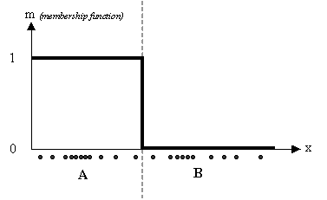
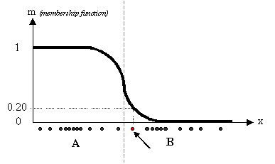
Problem Definition
Fuzzy Clustering in simple definition:
  To group/cluster N number of objects into M number of groups depends on defined criteria or similarity in some way.
  The goal of clustering is to determine the best grouping in a set of unlabeled data
  Crisp Clustering: the membership function of a cluster is based on either belonging to the cluster which normally indicates as 1 otherwise 0.
  In fuzzy clustering: the membership function of a cluster may vary from 1 to 0.
04/11/09

Slide 5
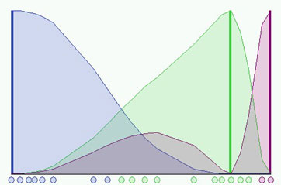
Fuzzy C-Means Algorithm
04/11/09

Slide 6
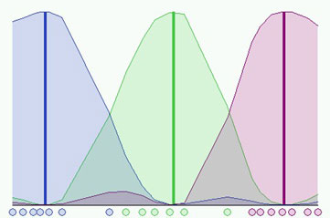
Fuzzy C-Means Algorithm
04/11/09

Slide 7
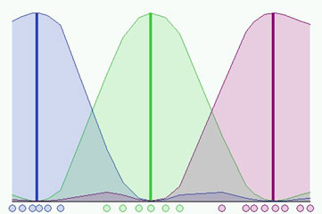
Fuzzy C-Means Algorithm
04/11/09

Slide 8
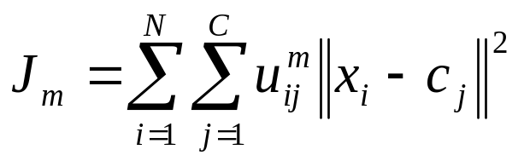
Fuzzy C-Means Algorithm
  Introduced and developed by Dunn then improved by Bezdek
  Based on minimising of an objective function:
    where:
      m is the fuzziness degree of any real number greater than 1.
      uij is the degree of membership of xi in the cluster j
      cj is the centre of the cluster j
      N is the number of data objects
      xi is the ith d-dimensional measured data object.
      ||*|| is any norm expressing the similarity between any measured data and the centre
  Main Disadvantage of the algorithm that it traps into local optimum
04/11/09

Slide 9
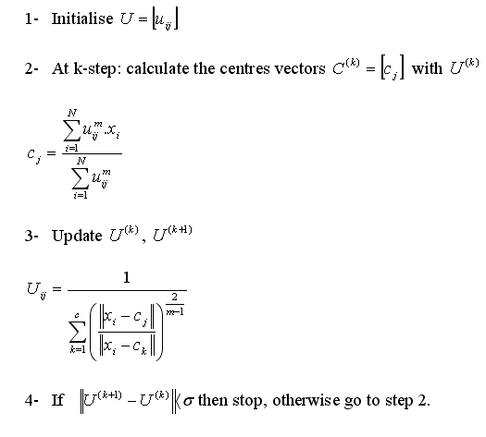
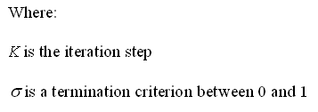
Fuzzy C-Means Algorithm
04/11/09

Slide 10
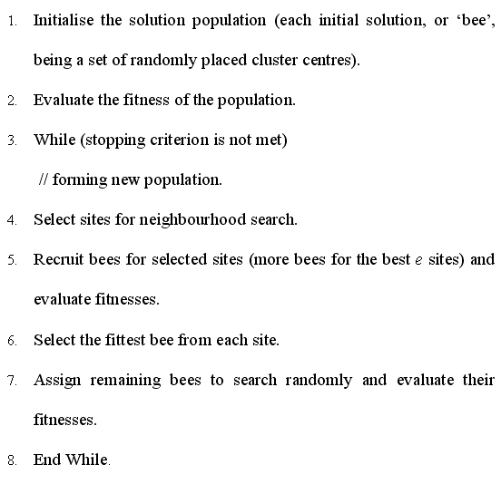
The Bees Algorithm
  Introduced and developed by Pham et al.
  An optimisation algorithm based on the food foraging behaviour of the honey-bees in nature
04/11/09

Slide 11
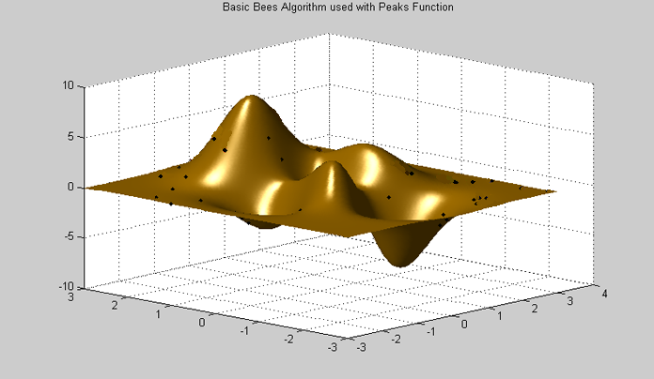
The Bees Algorithm
04/11/09
Notes:
Graph 1 shows a simple example of how the basic Bees Algorithm is working. First step is initialise a population of (n=10) scout bees with random search and evaluate the fitness.

Slide 12

The Bees Algorithm
04/11/09
Notes:
Graph 1 shows a simple example of how the basic Bees Algorithm is working. First step is initialise a population of (n=10) scout bees with random search and evaluate the fitness.

Slide 13
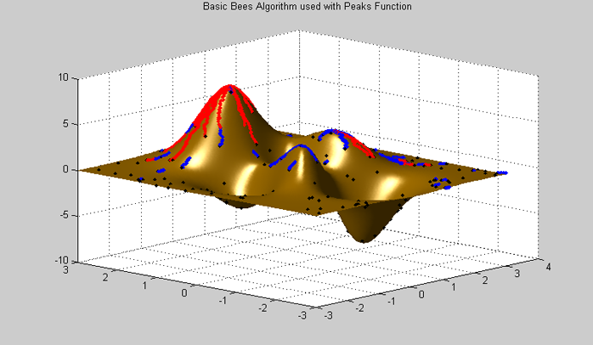
The Bees Algorithm
04/11/09
Notes:
Graph 1 shows a simple example of how the basic Bees Algorithm is working. First step is initialise a population of (n=10) scout bees with random search and evaluate the fitness.

Slide 14

Using The Bees Algorithm For Fuzzy Clustering
We used the Bees algorithm to find the minimum value of J
Eq (1)‏
04/11/09

Slide 15
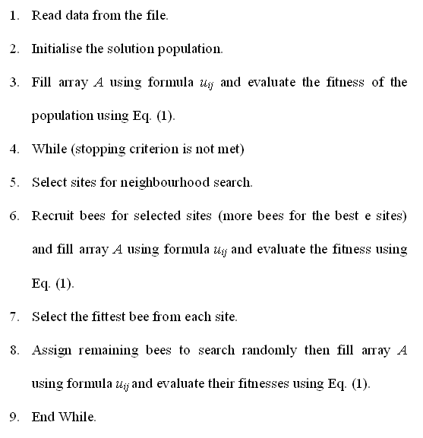
Proposed Algorithm Pseudo Code
04/11/09

Slide 16
Experiments
Data sets Summary
Data Set
# of Object
# of Feature
# of Class
Iris
150
4
3
Control Charts
1500
60
6
Wood Defects
232
17
13
Crude oil
59
5
3
04/11/09

Slide 17
Results
Data set
Algorithm
Mean
Min
Max
Iris
C-means
61.72
60.58
65.81
GA
65.54
63.34
69.23
Bees
60.58
60.58
60.58
Ctrl Charts
C-means
530.99
530.99
530.99
GA
802.08
791.23
819.28
Bees
549.08
546.87
552.15
Wood Defects
C-means
64077395.11
59195094.29
66225010.49
GA
168035.20
157508.00
174784.00
Bees
165132.52
153866.53
173523.00
Crude Oil
C-means
1330.43
1242.30
1560.57
GA
1252.61
1238.25
1286.04
Bees
1239.50
1237.24
1241.56
04/11/09

Slide 18
Conclusion
Combining the Bees Algorithm with (FCM) algorithm improved the fuzzy clustering results compared to the traditional C-means algorithm in most cases.
One of the main concerns of the current algorithm is that it requires long computing time.
04/11/09

Slide 19
Questions & Answers
Thank you.

